Slide 1
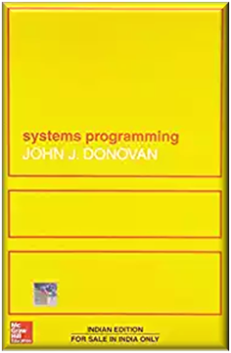
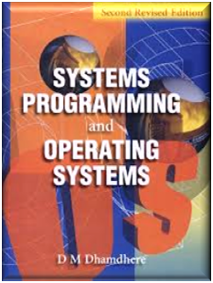
SPOS Unit-1 (cont..): Assembler
References
  “System Programming”, J. Donovan, McGraw Hill
  “System programming and operating System”, D. M. Dhamdhere, Tata McGraw Hill Edu. Pvt. Ltd.

Slide 2
Contents
Machine Structure
Machine language and Assembly Language
Assemblers: General design procedure
Design of two pass assembler

Slide 3
Machine Structure: IBM 360/370
Ref. Book –
John J. Donovan, "Systems Programming", Tata McGraw Hill

Slide 4
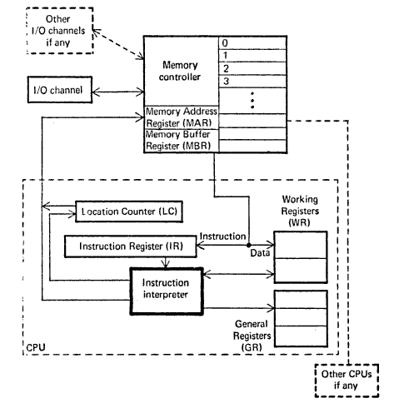

General machine structures
Notes:
The structure above consists of -
1. Instruction Interpreter
2. Location Counter
3. Instruction Register
4. Working Registers
5. General Register
The Instruction Interpreter Hardware is basically a group of circuits that perform the operation specified by the instructions fetched from the memory.
The Location Counter can also be called as Program/Instruction Counter simply points to the current instruction being executed.
Instruction Register keeps copy of current instruction.
The working registers are often called as the "scratch pads" because they are used to store temporary values while calculation is in progress.
This CPU interfaces with Memory through MAR & MBR
MAR (Memory Address Register) - contains address of memory location (to be read from or stored into)
MBR (Memory Buffer Register) - contains copy of address specified by MAR
Memory controller is used to transfer data between MBR & the memory location specified by MAR
The role of I/O Channels is to input or output information from memory.

Slide 5
Machine Structure
Memory
Registers
Data Formats
Instruction formats
instructions

Slide 6
Memory
Unit of Memory Bytes Length in bits
___________________________________
Byte 1 8
Halfword 2 16
Word 4 32
Doubleword 8 64

Slide 7
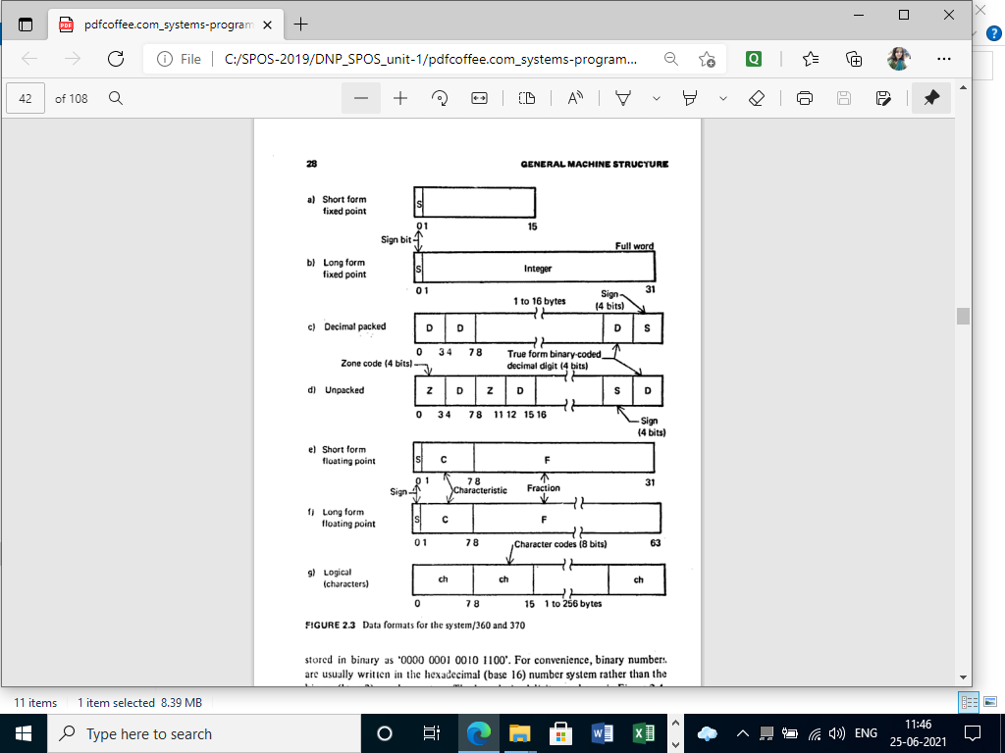
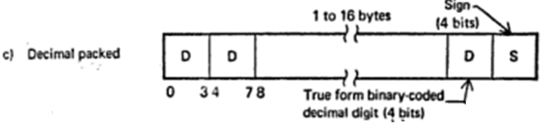
Data Formats

Slide 8
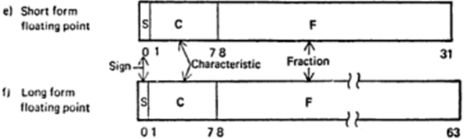
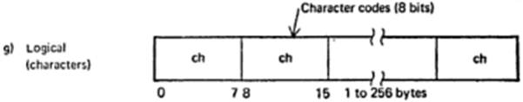
Data Formats

Slide 9
Registers
It has 16-general purpose registers (each of 32-bit)
  Used for arithmetic and logical operations and as a base register. Example -
    AX, BX, CX, DX, EX
    SI …..
    0, 1, 2,……..,15 (in 360 machine)
4 floating point registers (each of 64 bits)
  64 bit program status word (PSW) contains value of Location Counter (LC), protection info. and interrupt status.

Slide 10
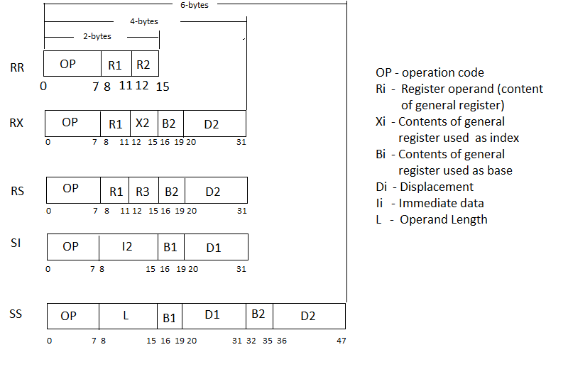
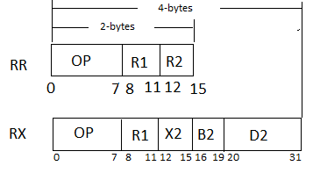



Addressing modes and Instruction Formats

Slide 11
Effective address (EA) or Physical Address (PA) calculation
RR-> contents of registers specifies required data
RX-> PA=c(xi)+c(Bi)+Di
RS-> PA=c(Ri)+c(Bi)+Di
SI -> PA=c(Bi)+Di
SS -> op1_PA=c(Bi)+Di & op2_PA=c(Bi)+Di

Slide 12
Instructions
IBM 360 supports following type of instructions:
  Arithmetic ,
  Logical,
  Control or transfer,
  Special Interrupt
Few examples from above category

Slide 13
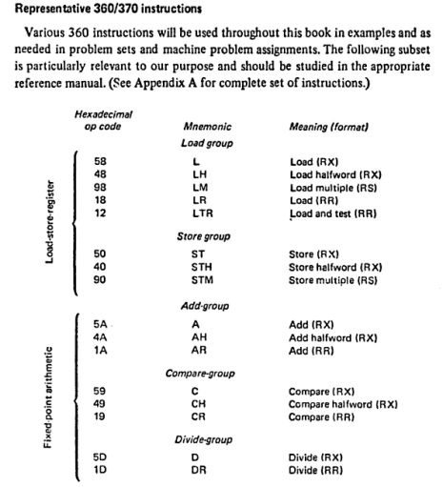

Slide 14
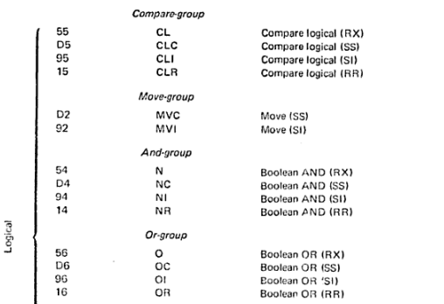

Slide 15
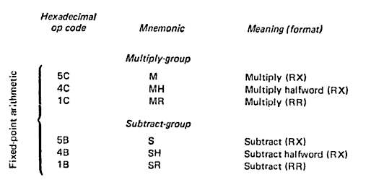

Slide 16
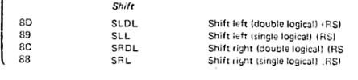

Slide 17
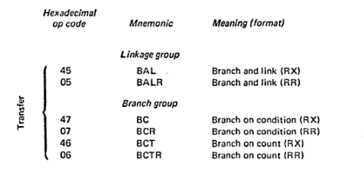

Slide 18
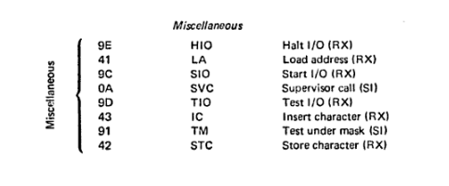

Slide 19



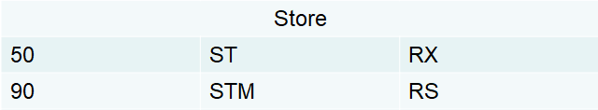
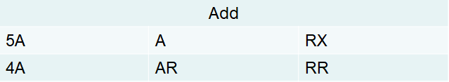
Instruction (cont..)

Slide 20
Instruction (cont..)
Hexadecimal Format | Mnemonic | Format
Compare
59 | C | RX
19 | CR | RR
Branch
47 | BC | RX
07 | BCR | RR
46 | BCT | RX
06 | BCTR | RR
Linkage
45 | BAL | RX
05 | BALR | RR

Slide 21
Assembler
Assembler
Source Program
I/P
Target Program
O/P
(Program Written in Assembly Language)
( Program in m/c understandable form along with information for loader )
Data Bases

Slide 22
Elements of Assembly Language Programming
It is a Machine (m/c) dependent language.
It provides basic 3-features
  Mnemonic operation codes (op codes)
  Symbolic operands
  Data Declarations

Slide 23
Assembly statement format
[Label] <opcode> <operand spec>[, <operand spec2>,….]
<operand spec> Syntax: Specified using various addressing modes
  <Symboic name> [+ displacement] or [+(index register)]
  Ex.
  TEMP
  TEMP+5
  TEMP(4)
  TEMP+5(4)

Slide 24
Assembly Language Statements
There are three types of statements :
  Imperative Statements
  Declaration Statements
  Assembler Directives

Slide 25
Imperative Statements
It specifies action to be performed during execution of assembled program.
Each imperative statement typically translated into one m/c instruction.
Ex.
  MOV A,TEMP
  ADD A, #2

Slide 26
Declaration Statements
A
Syntax:
[ Label ] DS <constant>
[ Label ] DC <‘value’>
DS: Declare Storage
  A DS 1
  -> reserves 1 word
DC: Declare Constant
  ONE DC ‘1’
1-word
Mem. Location 2000
ONE
1
Mem. Location 1001

Slide 27
Assembler Directives
It directs assembler to perform some actions during assembly of a program
Ex.
  START <const>
  END
  USING
  LTORG
  EQU
  etc.

Slide 28
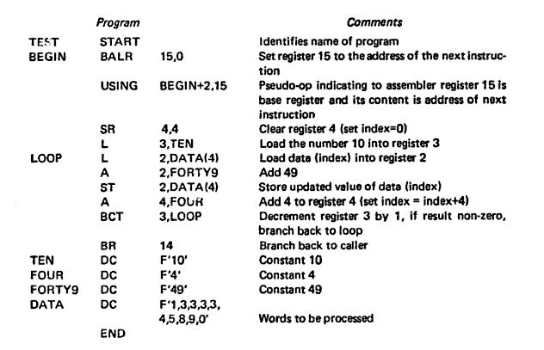
An Assembly Language Program

Slide 29
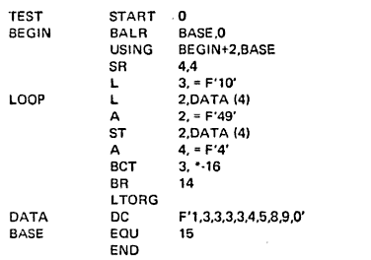
An Assembly Language Program Using Literals

Slide 30
Example-1
Label/ Symbol
Assembler Directives
Start address/ origin
SAMPLE START 100
USING *,15
L 1, FOUR
A 1,=F’3’
ST 1,RESULT
SR 1,2
FOUR DC F’4’
RESULT DS 1F
END
register
Imperative
Statements/
mnemonics
register
literal
register
Label/ Symbol
Declarative Statements
Value of symbol
F-> full word
Memory size for sym.
F-> full word
Assembler
Directives

Slide 31
Assembler can be implemented in following way
Pass structure
  passes are the number of times the assembler traverses through the source code. (A pass can have more than one phases)
Phase structure
  phases are the steps in the assembly process, which takes input from the previous stage (phase), processes and yields output that can be used as input for the next stage

Slide 32
Pass structures of assembler
One Pass assembler
Two pass assembler

Slide 33
One pass assembler
Entire program translated in single pass & handles ‘forward references’ using ‘Backpatching’
Backpatching:
  Operand field of symbol is left blank for forward reference.
  As soon as reference/ declaration found for that symbol it is inserted in all incomplete instructions.

Slide 34
Two Pass assembler
Pass-I: Analyzes source program
Pass-II: Synthesizes target program
Data structures/ Data bases
Symbol Table
Literal Table
Source
Program
Target
Program
PASS-I
Intermediate Representation
PASS-II
IR code/
output of
pass-I
Data access
Control Transfer

Slide 35
Purpose of Pass I & II
Pass-I: Define symbols & literals
  Determine Length of instruction
  Keep track of Location counter (LC)
  Remember/store values of symbol for pass-II
  Process some pseudo-ops (EQU, DS)
  Remember Literals
Pass-II: Generate object program
  Look up values of symbols
  Generate target instruction
  Generate data (DC, DS & literals)
  Process some pseudo-ops

Slide 36
Design Specification of Two Pass Assembler
Specify problem statement
Specify data structure used
Define format for data structures
Specify algorithm
Look for modularity
Repeat steps 1-5 for each module

Slide 37
1. Specify problem statement
1. JOHN START 0
2. USING *,15
3. L 1,FIVE
4. A 1,FOUR
5. ST 1,RESULT
6. FOUR DC F’4’
7. FIVE DC F’5’
8. RESULT DS 1F
9. END

Slide 38
1. Specify problem statement (Cont..)
Output of pass-I
Stmt. Relative Mnemonic
No. Address Instruction
(LC)
3. 0 L 1,__(0,15)
4. 4 A 1,__(0,15)
5. 8 ST 1,__(0,15)
6. 12 4
7. 16 5
8. 20 ___

Slide 39
1. Specify problem statement (Cont..)
Output of pass-II:
Stmt. Relative Mnemonic
No. Address Instruction
(LC)
3. 0 58 1,16(0,15)
4. 4 5A 1,12(0,15)
5. 8 50 1,20(0,15)
6. 12 4
7. 16 5
8. 20 ___

Slide 40
2. Specify data structure used
Pass-I
  Input as source program
  Location counter (LC)
  Machine operation table (MOT)
  Pseudo operation table (POT)
  Symbol Table (ST)
  Literal Table (LT)
  Intermediate output file used by pass-II

Slide 41
2. Specify data structure used (cont..)
Pass-II:
  Intermediate output provided by pass-I
  Location Counter (LC)
  MOT
  POT
  ST
  LT
  Base Table (BT)
  Output of Pass-II

Slide 42
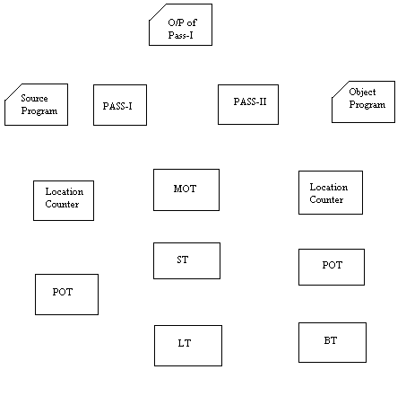
2. Specify data structure used (cont..)

Slide 43
3. Define format for data structures

Slide 44
1. Machine –Op Table (MOT)
Mnemonic Opcode (4-bytes) (Character) | Binary Opcode (1-byte) (Hexadecimal) | Instruction Length (2-bit) (Binary) | Instruction Format (3-bits) (Binary) | Unused in this design (3-bits)
“A-------” | 5A | 4 | RX
“AH-----” | 4A | 4 | RX
… | … | … | … | …
... | … | … | … | …
“L------” | 58 | 4 | RX
“LR----” | 18 | 2 | RR
… | … | … | … | …
... | … | … | … | …
Instruction Length
1-half word | 2-Bytes
2-half Word | 4- Bytes
3- half Word | 6- Bytes
Instruction Format
RR
RX
RS
SI
SS
6-bytes per entry

Slide 45
2. Pseudo-Op Table (POT)
Pseudo Opcode (5-bytes) (Character) | Address of routine to process pseudo-op (3-bytes= 24bit address)
“DROP_” | P1DROP
“END___” | P2END
… | …
... | ...
“EQU___” | P3EQU
“START_” | P4START
… | …
... | ...
8-bytes per entry

Slide 46
3. Symbol Table (ST)
Symbol (8-bytes) (characters) | Value / address (4-bytes) (Hexadecimal) | Length (1-bytes) (Hexadecimal) | Relocation (1-byte) (character)
“JOHN__” | 0000 | 01 | “R”
“FOUR__” | 000C | 04 | “R”
… | … | … | …
... | … | … | …
14-bytes per entry

Slide 47
4. Literal Table (LT)
Literal (8-bytes) (characters) | Value / address (4-bytes) (Hexadecimal) | Length (1-bytes) (Hexadecimal) | Relocation (1-byte) (character)
=F’3’ | 0000 | 01 | “R”
=F’4’ | 000C | 04 | “R”
… | … | … | …
... | … | … | …
14-bytes per entry

Slide 48
5. Base Table (BT)
Sr. No. | Availability indicator (1-byte) (character) | Designed relative address contents of base register (3-bytes) (Hexadecimal)
1 | “N” | -
2 | “N” | -
. | … | …
. | ... | ...
. | … | …
. | ... | ...
15 | Y | 100
4-bytes per entry

Slide 49
4. Specify algorithm
Pass1-link
Pass2-link

Slide 50
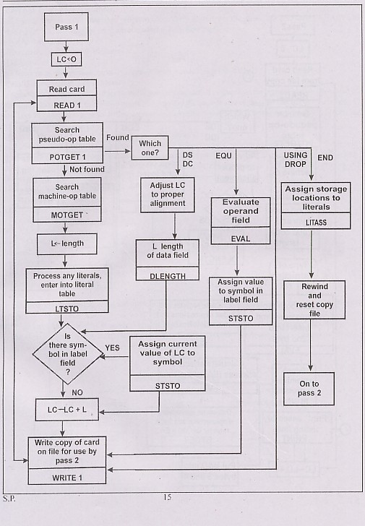

Slide 51
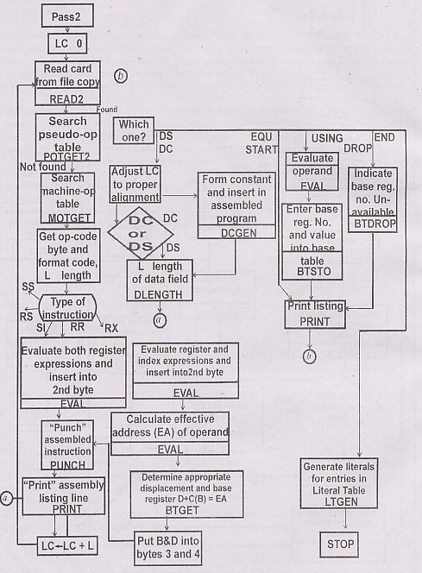

Slide 52
5. Look for modularity
Line=Readline(file)
Tokens=Token(line)
SearchPOT(token)
SearchMOT(token)
SearchST(sym)
AddST(sym_tuple)
SearchLT(literal)
AddLT(literal)
Tokenize_Operands(T)
Writeline(out_file)
Error_handler()
Start_P()
Ltorg_P()
DC_P()
:
:
6. Repeat steps 1-5 for each module

Slide 53
Example-2
1
2
3
4
5
6
7
8
9
10
11
12
13
14
15
16
TEST START
BEGIN BALR 15,0
USING BEGIN+2, 15
SR 4,4
L 3,TEN
LOOP L 2,DATA(4)
A 2,FORTY9
ST 2,DATA(4)
A 4,FOUR
BCT 3,LOOP
BR 14
TEN DC F’10’
FOUR DC F’4’
FORTY9 DC F’49’
DATA DC F’1,3,3,3,3,4,5,8,9,0’
END

Slide 54
Example-3 (Home Work)
1
2
3
4
5
6
7
8
9
10
11
12
13
14
TEST START 0
BEGIN BALR 15,0
USING BEGIN+2, 15
SR 4,4
L 3,=F’10’
LOOP L 2,DATA(4)
A 2,=F’49’
ST 2,DATA(4)
A 4,=F’4’
BCT 3,*-16
BCR 15,14
LTORG
DATA DC F’1,3,3,3,3,4,5,8,9,0’
END

Slide 55
solution
MOT
Mnemonic | Hex code | Length | format
BALR | 05 | 2 | RR
L | 58 | 4 | RX
SR | 1B | 2 | RR
A | 5A | 4 | RX
ST | 50 | 4 | RX
BCT | 46 | 4 | RX
BR/BCR | 07 | 2 | RR
LC PASS1-OP
0 BALR 15,0
SR 4,4
L 3,#1(0,15)
8 L 2,$4(4,15)
A 2,#2(0,15)
ST 2,$4(4,15)
A 4,#3(0,15)
24 BCT 3,*-16
BCR 15,14
-----
10
49
4
1
48
:
BT
REG. NO. | VAL
15 | 2
ST
Symbol | Addr | Length | Relocatio
TEST | 0 | 1 | R
POT
Pseudo code | Routine address
START | S_P1()
USING | U_P2()
EQU | E_P3()
LTORG | L_P4()
DC | D_P5()
DS | DS_P6()
END | EN_P7()
BEGIN | 0 | 2 | R
LOOP | 8 | 4 | R
DATA
DATA | 44 | 4 | R
LT
Literal | Addr | Length | Relocatio
=F’10’ | 32 | 4 | R
Literal | Addr | Length | Relocatio
=F’10’
=F’49’ | 36 | 4 | R
=F’49’
=F’4’
=F’4’ | 40 | 4 | R

Slide 56
Pass-2 output
LC PASS1-OP
0 05 15,0
1B 4,4
58 3,30(0,15)
8 58 2,42(4,15)
5A 2,34(0,15)
50 2,42(4,15)
5A 4,38(0,15)
24 46 3,6(0,15)
07 15,14
-----
10
49
4
1
48
:

Slide 57
Example-4
PRGAM2 START 0
USING *,15
LA 15,SETUP
SR TOTAL,TOTAL
AC EQU 2
INDEX EQU 3
TOTAL EQU 4
DATABASE EQU 13
SETUP EQU *
USING SETUP,15
L DATABASE,=A(DATA1)
USING DATAAREA,DATABASE
SR INDEX,INDEX
LOOP L AC,DATA1(INDEX)
AR TOTAL,AC
A AC,=F'5'
ST AC,SAVE(INDEX)
A INDEX,=F'4'
C INDEX,=F'8000'
BNE LOOP
LR 1,TOTAL
BR 14
LTORG
SAVE DS 2000F
DATAAREA EQU *
DATA1 DC F'25,26,27.......' (2000 NUMBERS)
END
Mnemonic | Hex code | Length | format
LA | 41 | 4 | RX
L | 58 | 4 | RX
LR | 18 | 2 | RR
SR | 1B | 2 | RR
AR | 1A | 2 | RR
A | 5A | 4 | RX
ST | 50 | 4 | RX
C | 59 | 4 | RX
BNE/BC | 47 | 4 | RX
BR/BCR | 07 | 2 | RR
MOT
POT
Pseudo code | Routine address
START | S_P1()
USING | U_P2()
EQU | E_P3()
LTORG | L_P4()
DC | D_P5()
DS | DS_P6()
END | EN_P7()

Slide 58
Example-4
PRGAM2 START 0
USING *,15
LA 15,SETUP
SR TOTAL,TOTAL
AC EQU 2
INDEX EQU 3
TOTAL EQU 4
DATABASE EQU 13
SETUP EQU *
USING SETUP,15
L DATABASE,=A(DATA1)
USING DATAAREA,DATABASE
SR INDEX,INDEX
LOOP L AC,DATA1(INDEX)
AR TOTAL,AC
A AC,=F'5'
ST AC,SAVE(INDEX)
A INDEX,=F'4'
C INDEX,=F'8000'
BNE LOOP
LR 1,TOTAL
BR 14
LTORG
SAVE DS 2000F
DATAAREA EQU *
DATA1 DC F'25,26,27.......' (2000 NUMBERS)
END
Mnemonic | Hex code | Length | format
LA | 41 | 4 | RX
L | 58 | 4 | RX
LR | 18 | 2 | RR
SR | 1B | 2 | RR
AR | 1A | 2 | RR
A | 5A | 4 | RX
ST | 50 | 4 | RX
C | 59 | 4 | RX
BNE/BC | 47 | 4 | RX
BR/BCR | 07 | 2 | RR
MOT
POT
Pseudo code | Routine address
START | S_P1()
USING | U_P2()
EQU | E_P3()
LTORG | L_P4()
DC | D_P5()
DS | DS_P6()
END | EN_P7()

Slide 59
Example -5
SUB START 100
USING SUB,15
USING TABLE,3
L 4,FIFTY
L 5,B
BCR 15,14
FIFTY DC H’50’
TABLE DESECT
A DS 1F
B DS 1H
C DS 1H
END

Slide 60
Example -6
OCT START 0
USING *,15
BALR 15,0
L 10,DATA2
USING DATA2,10
DROP 15
L 1,DATA2
DATA1 DC F’1’
DATA2 DC F’2’
DATA3 DC F’3’
END

Slide 61
Summary
General Machine Architecture
Memory units
Registers
Data formats
Instruction formats/ Addressing Modes
Assembler
Two pass assembler
Design of two-pass assemler

Slide 62
Theory Questions
What are the data formats? Explain them in detail?
Draw and explain general machine architecture?
What are the instruction formats? Explain them in detail?
What is assembler? Or Define assembler?
Explain pass structure of assembler?
Explain Design of two pass assembler?
Draw flowchart of pass-1 of two pass assembler and explain it?
Draw flowchart of pass-2 of two pass assembler and explain it?
What are the data structure used in two pass assembler? Explain them with suitable example?
Explain various field of following data structures
  MOT
  POT
  ST
  LT
  BT

Slide 63

Any Questions ?

